Slide 1

WebAssembly in parquet-wasm and Lonboard
Kyle Barron
Development Seed

Slide 2
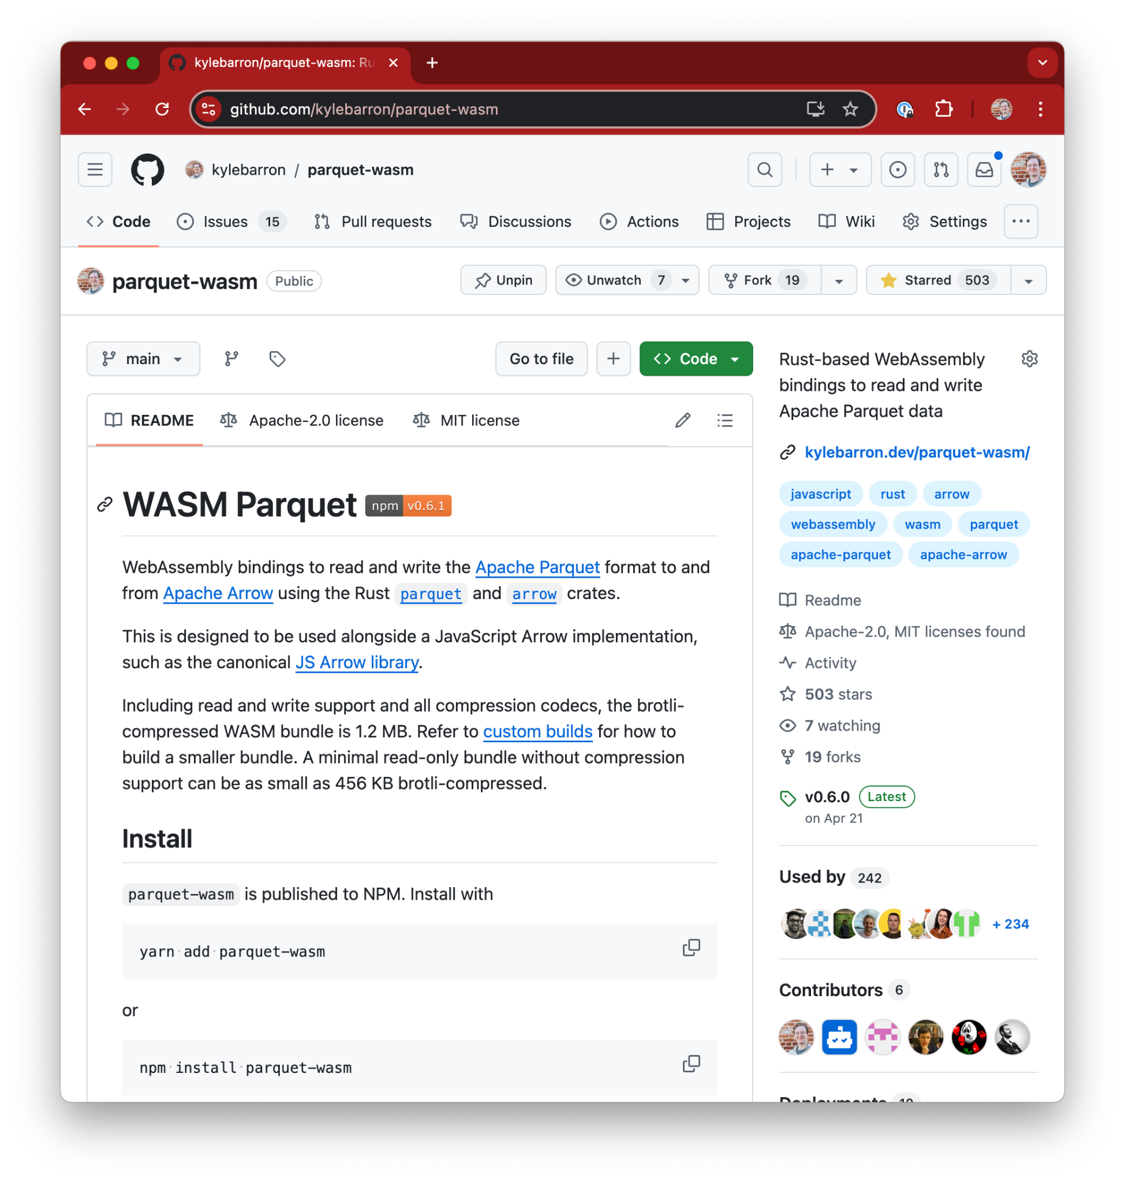
parquet-wasm
Early 2022, wanted to learn Rust + Wasm
Tabular file format with excellent compression
Parse Parquet files to Arrow memory
Strengths of Wasm:
Reuse existing, stable Rust Parquet library
Decompression, decoding binary buffers
Fast
Strength of Rust:
Ugly code, but functional in a few weeks
~1MB library size
Notes:
Needed to find meaningful project
Been working with Parquet files
Possible to write this all in JS, but would be a massive time/engineering investment

Slide 3
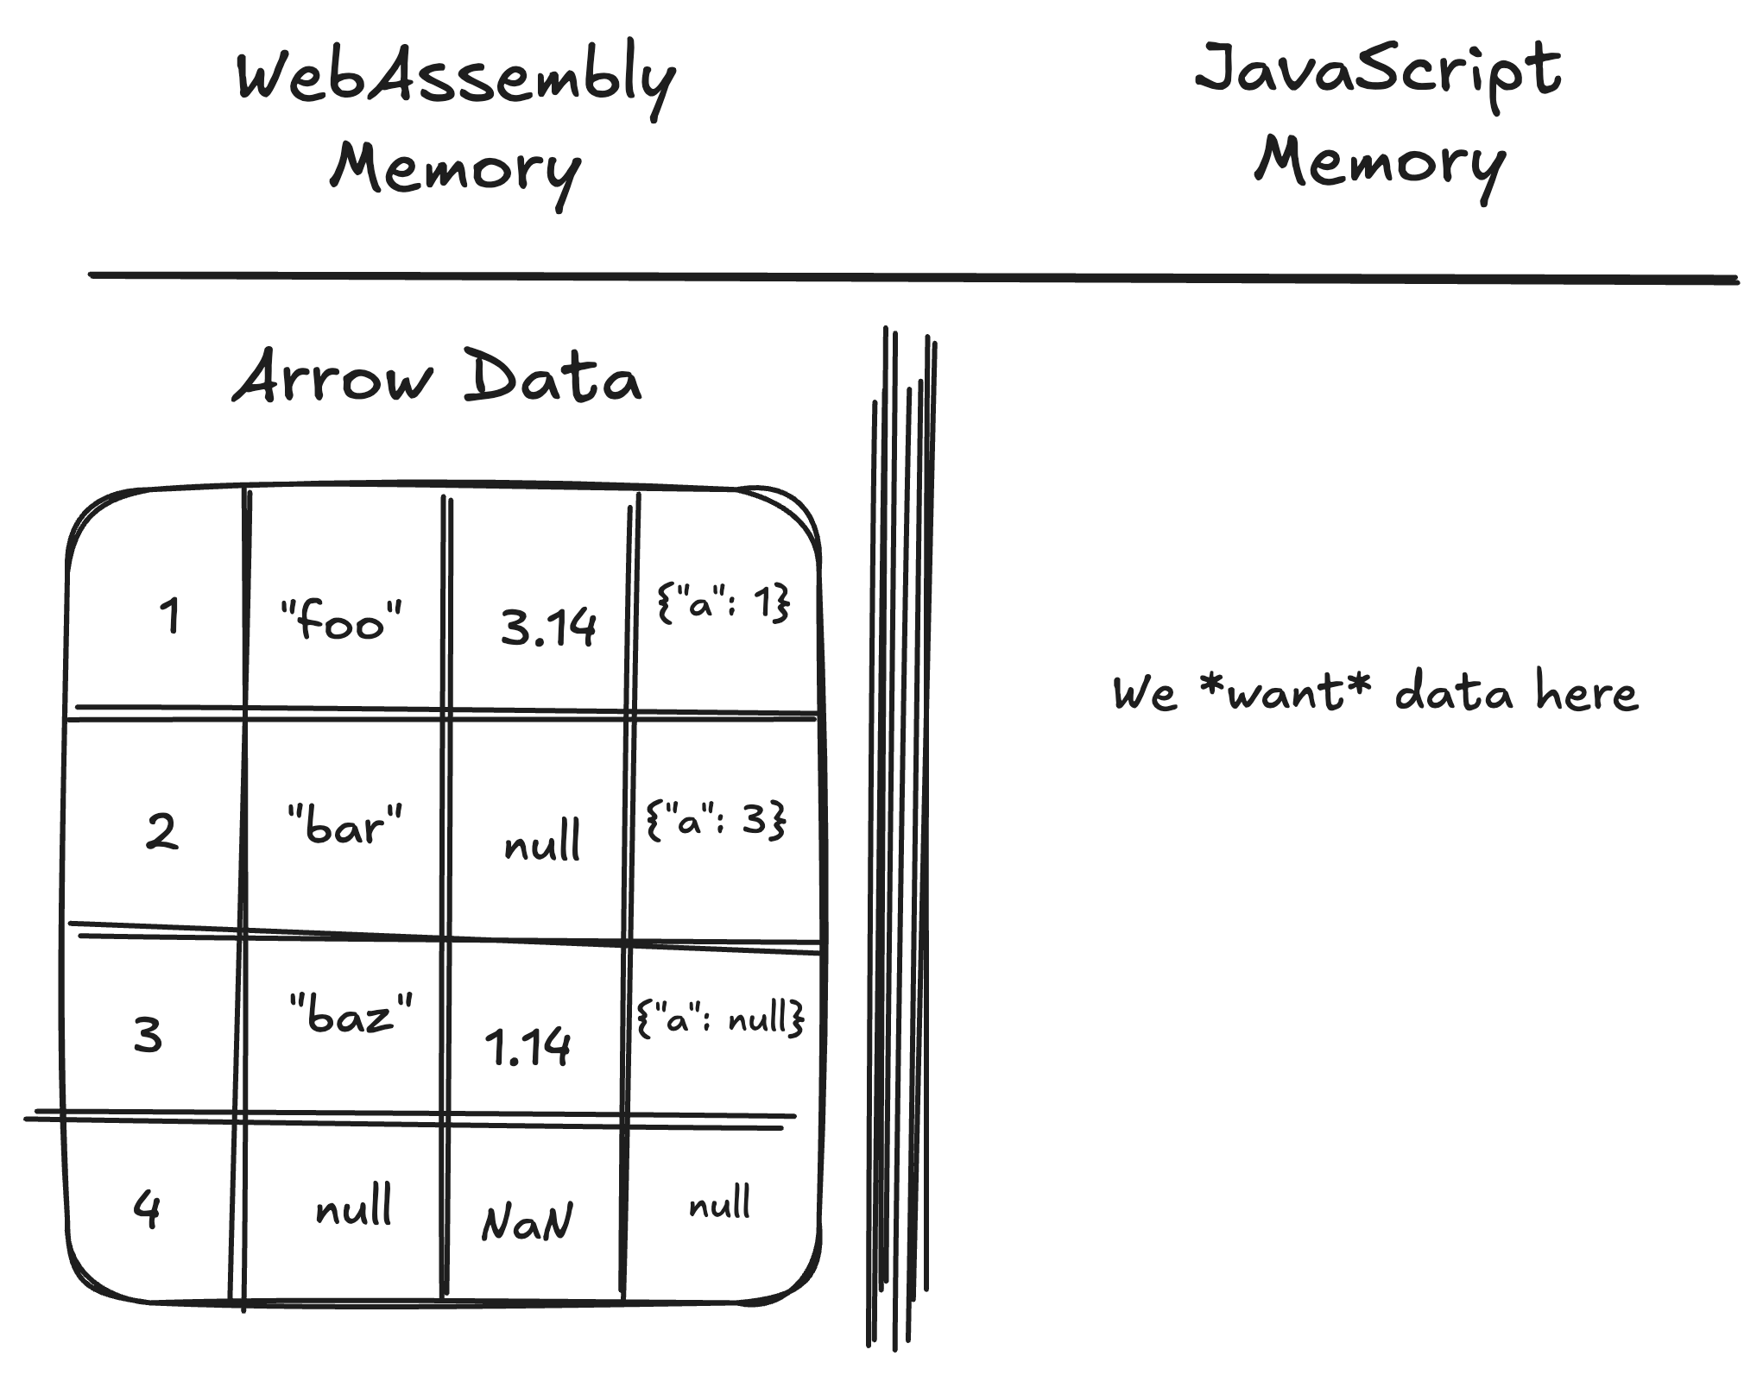
WASM Data Boundary
We’ve parsed Parquet to Arrow in WASM…
But we really want this data in JavaScript
Notes:
Needed to find meaningful project
Been working with Parquet files
Possible to write this all in JS, but would be a massive time/engineering investment

Slide 4
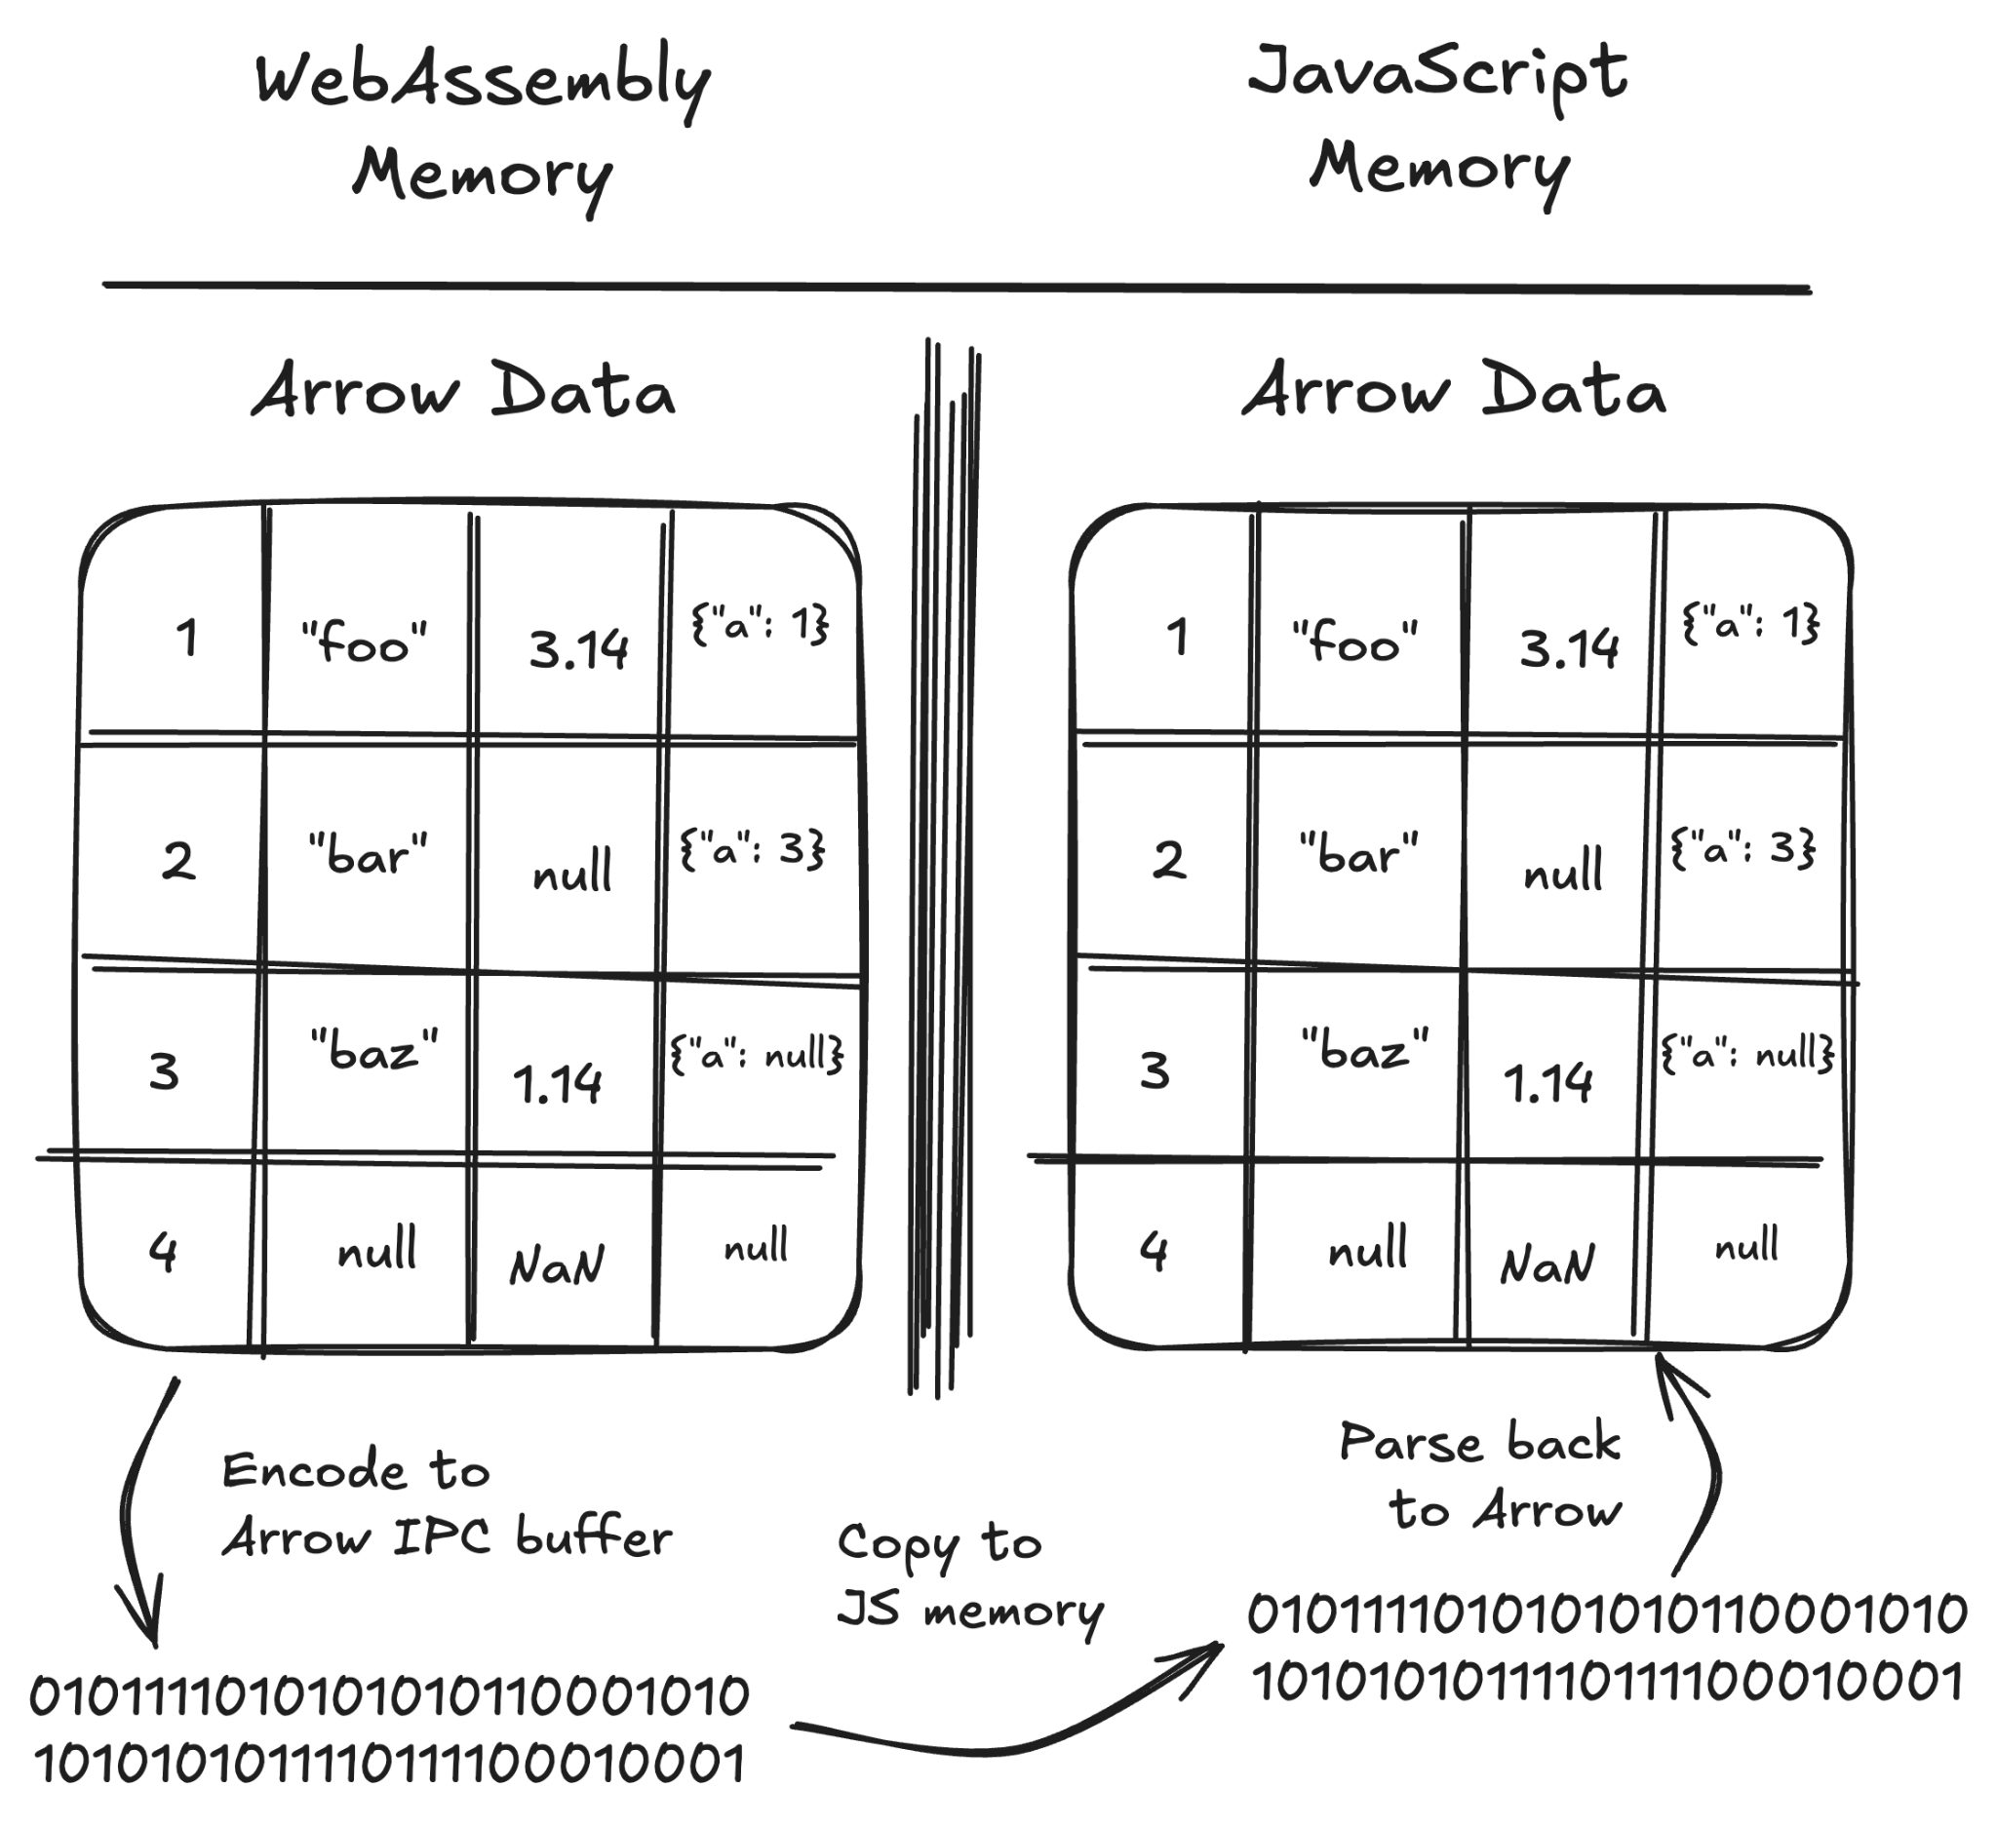
Arrow IPC option
Serialized buffer
Default option:
Serialize to Arrow IPC
Parse back with Arrow JS
We just parsed to Arrow… now we have to encode it to get it out of WASM??
Two full memory copies
(No copy needed from Arrow IPC on the JS side)
Notes:
Easy but has overhead

Slide 5
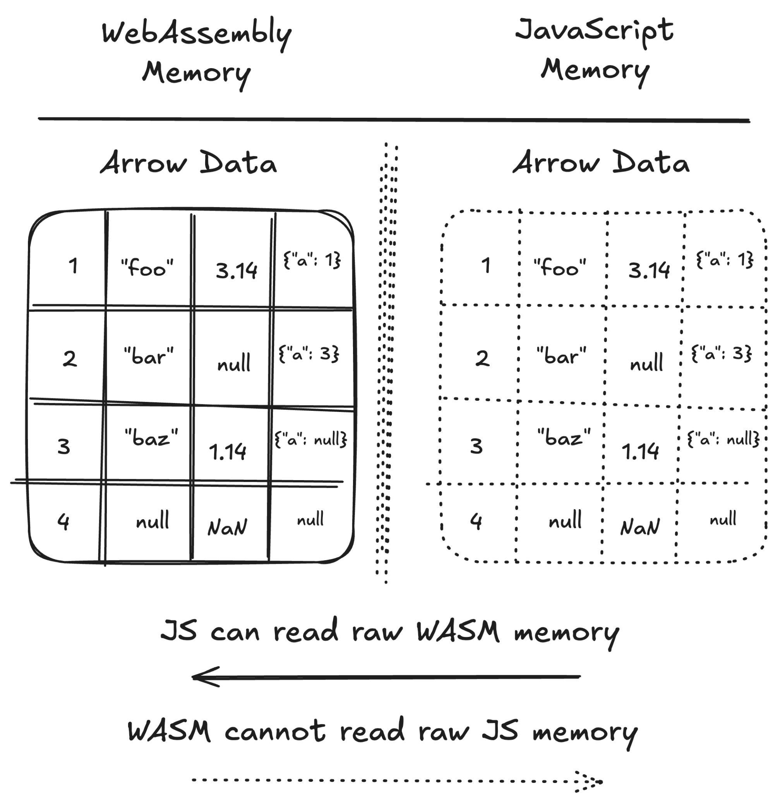
Avoiding extra data copies
Direct views?
Arrow is language-independent
Arrow JS and whatever Arrow implementation is used in Wasm (Rust, C++, etc) all have the same underlying representation
Can we avoid copies?
Notes:
A slightly porous boundary

Slide 6
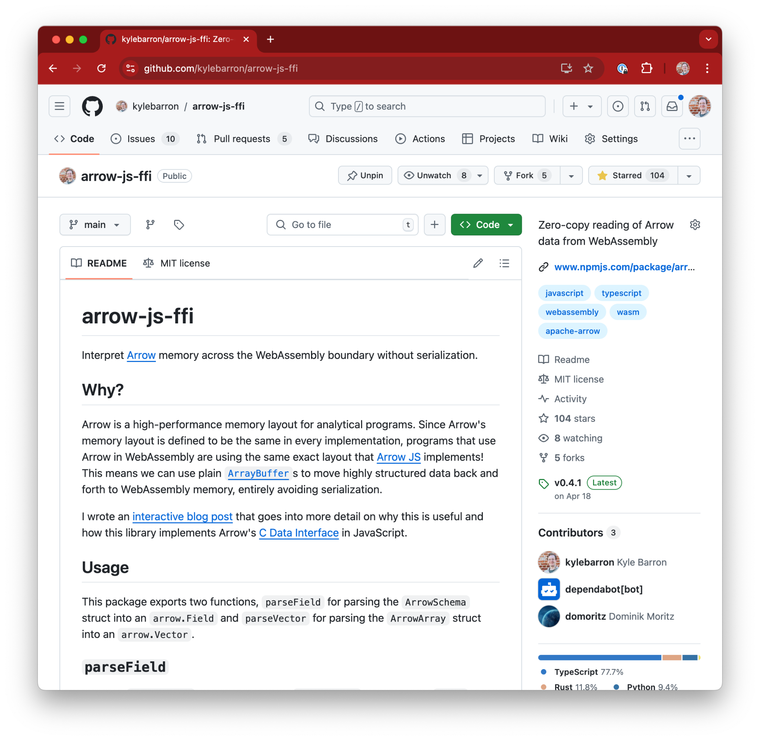
arrow-js-ffi
View or copy Arrow data directly from Wasm
View:
Arrow JS Table a reference onto Wasm ArrayBuffer
Buffers neutered when WASM memory resizes
Consider lifetime of WASM data
Prevent JS/Wasm data out of sync
Views are immutable from JS
Views need manual memory management
Copy:
Still more efficient than going through IPC
Separately-allocated arrays (nicer for web workers)
Notes:
Needed to find meaningful project
Been working with Parquet files
Possible to write this all in JS, but would be a massive time/engineering investment

Slide 7
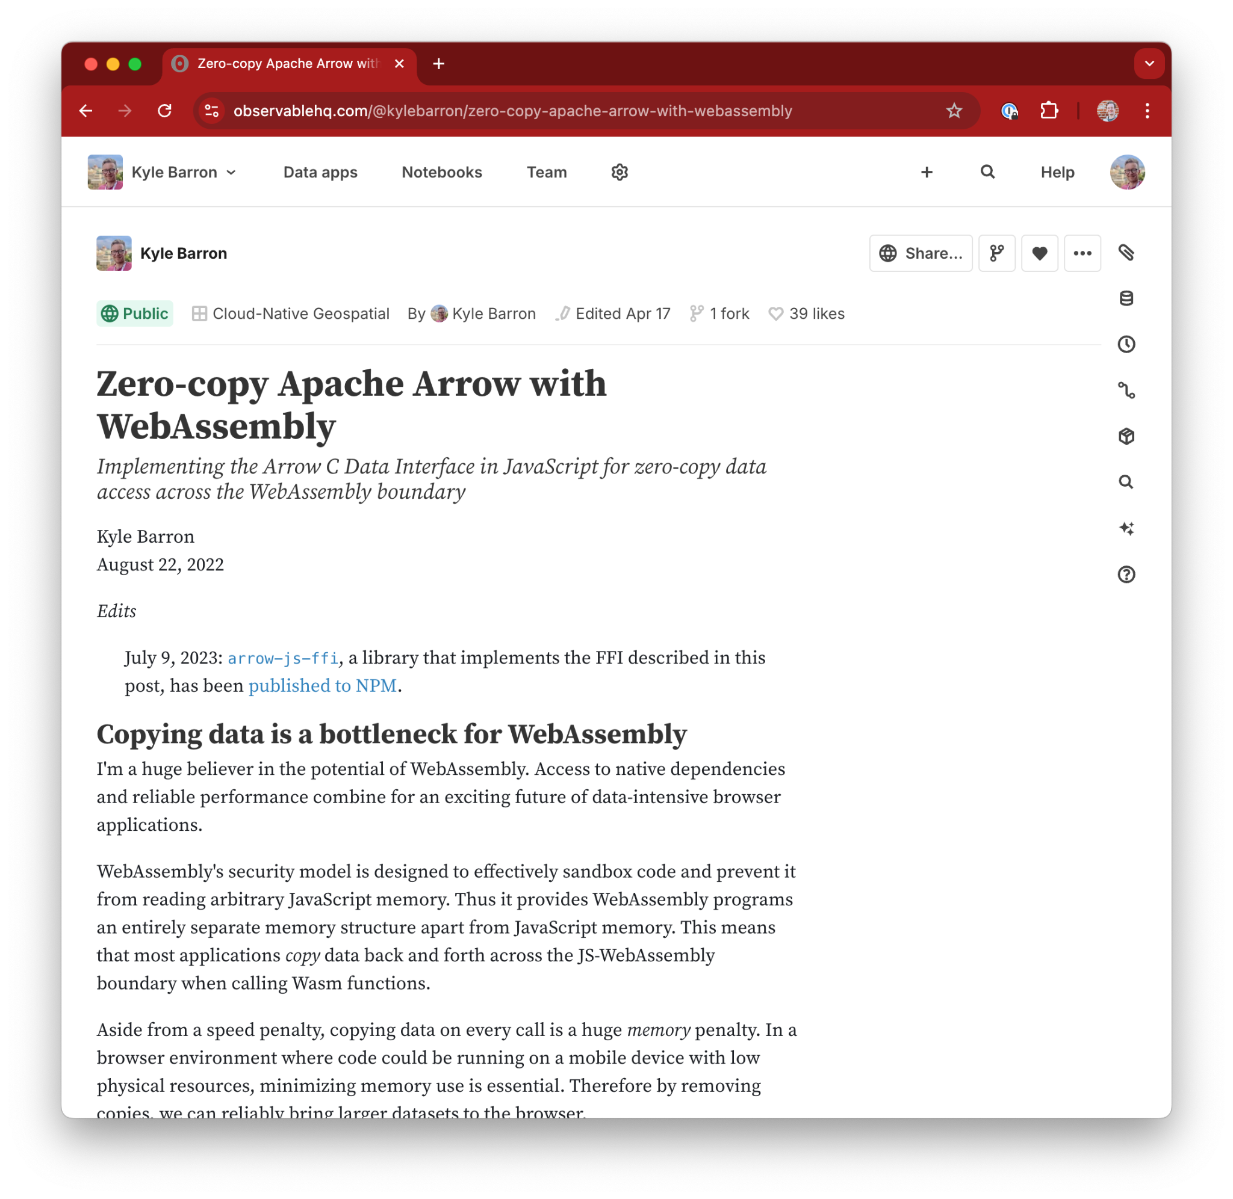
arrow-js-ffi
Interactive Observable blog post
https://observablehq.com/@kylebarron/zero-copy-apache-arrow-with-webassembly
Notes:
Needed to find meaningful project
Been working with Parquet files
Possible to write this all in JS, but would be a massive time/engineering investment

Slide 8
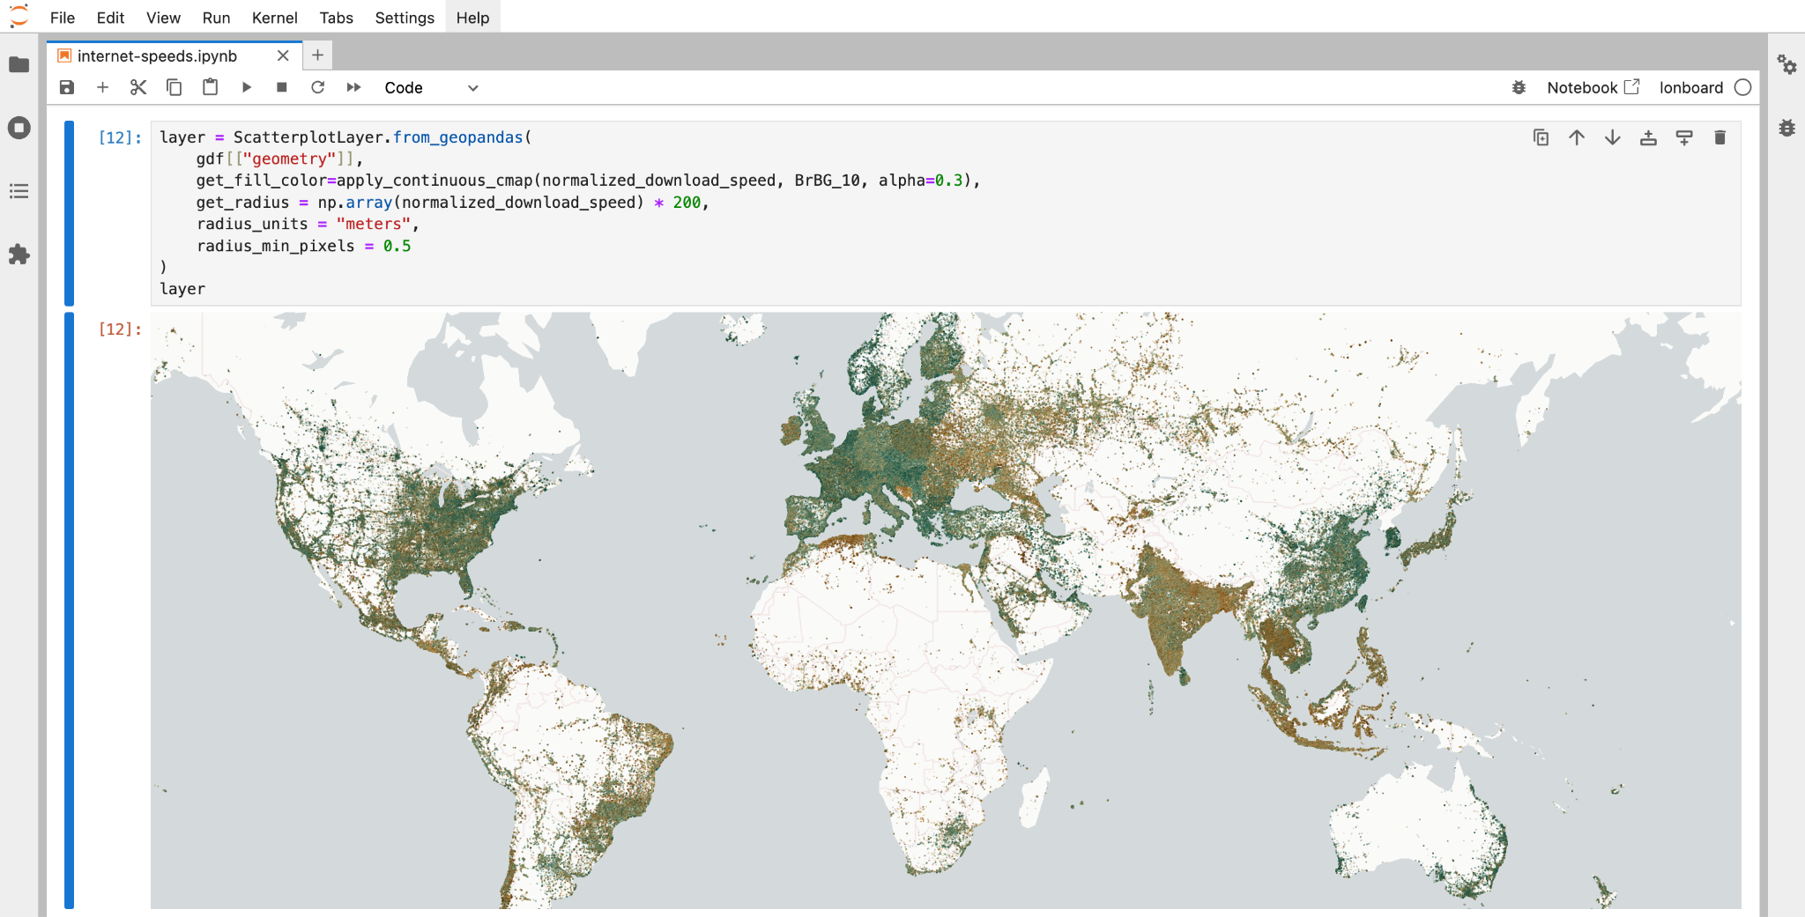
ds.io/lonboard
Lonboard: fast geospatial data visualization from Python

Slide 9
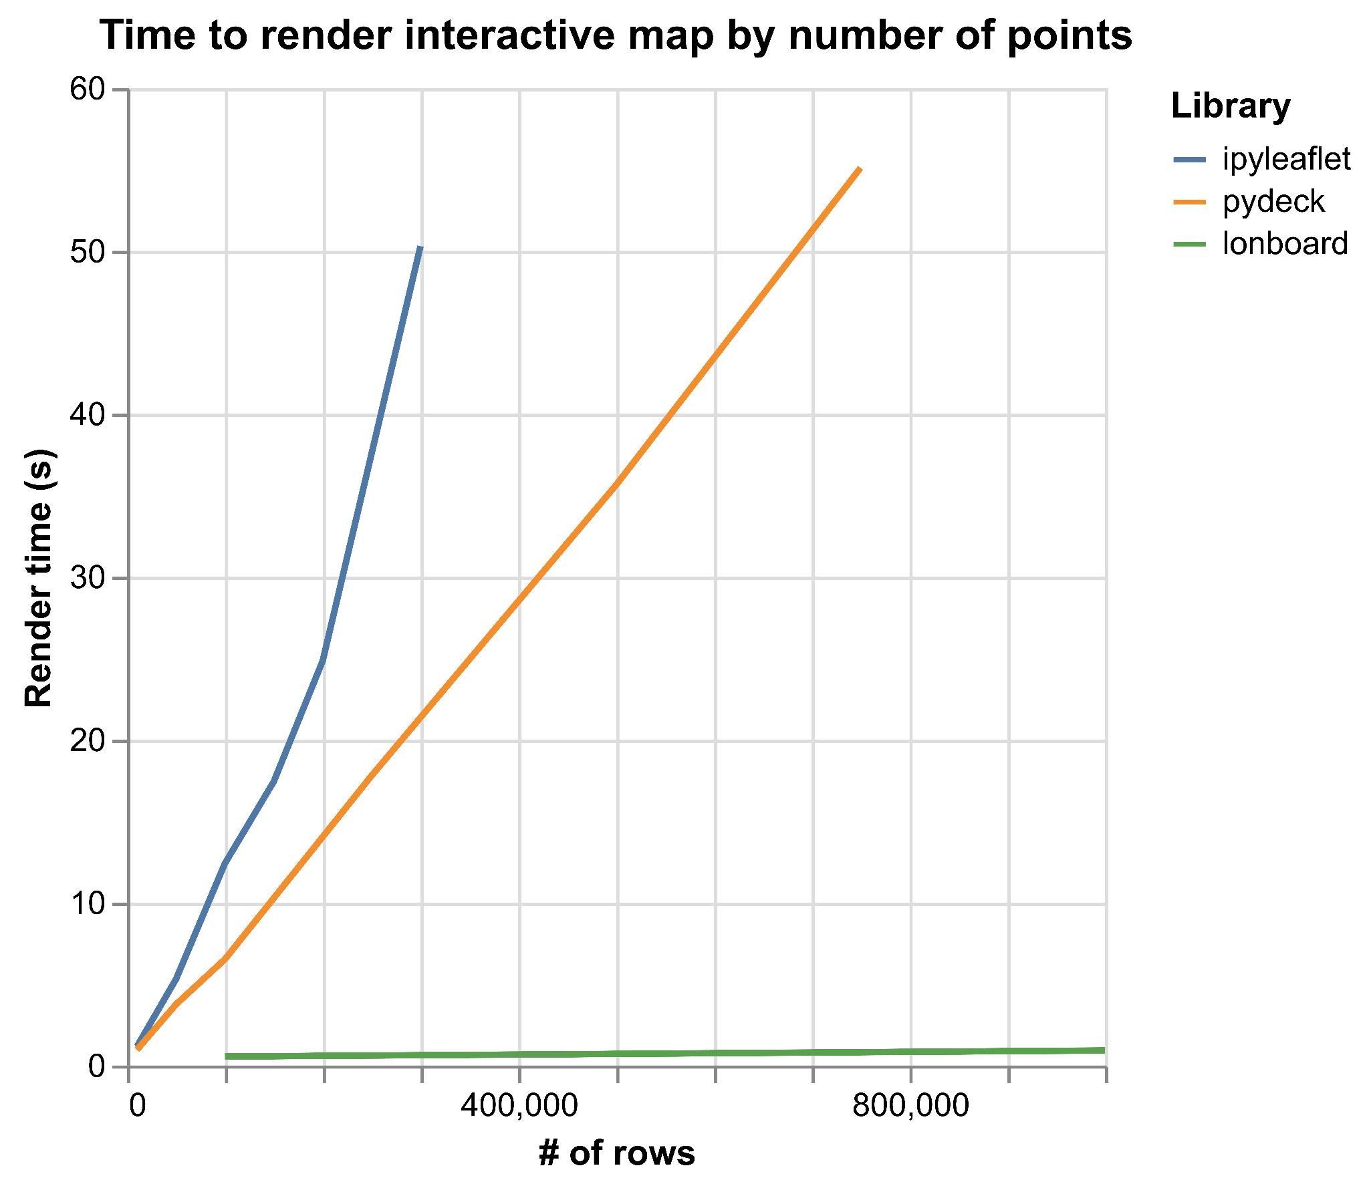
ipyleaflet/
pydeck/
lonboard
Notes:
Failed at 1.2 million points (after 90 seconds)

Slide 10
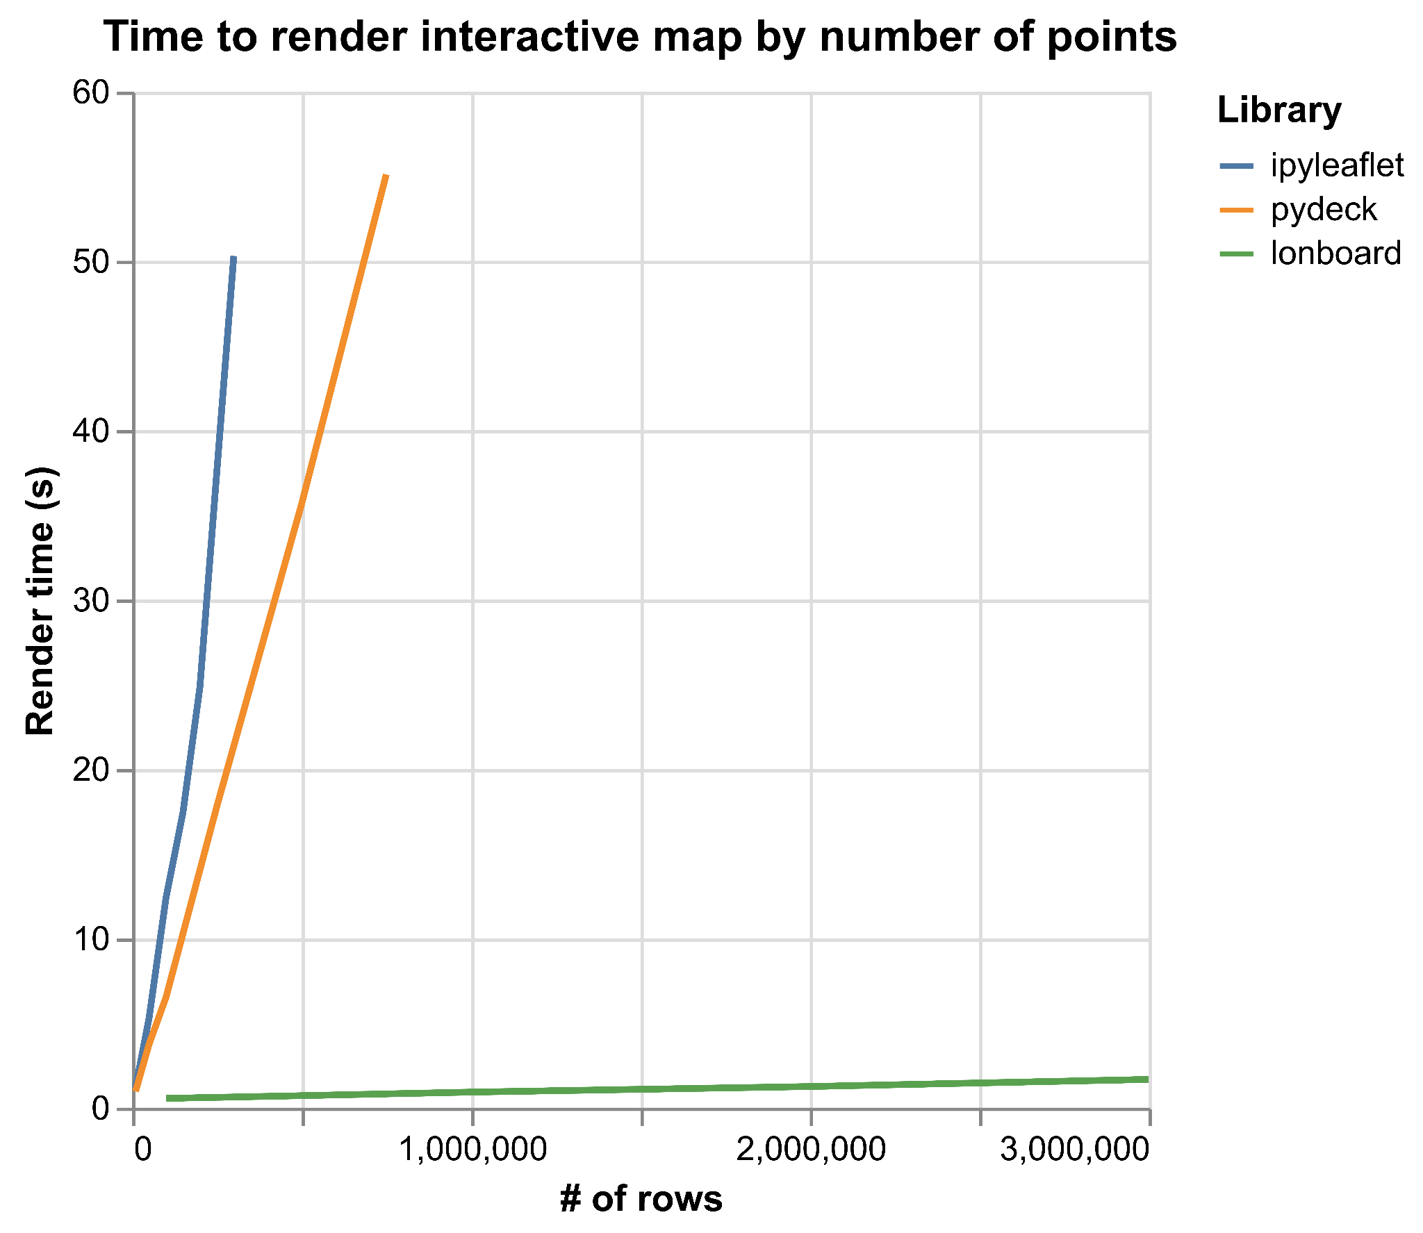
ipyleaflet/
pydeck/
lonboard
Notes:
Failed at 1.2 million points (after 90 seconds)

Slide 11
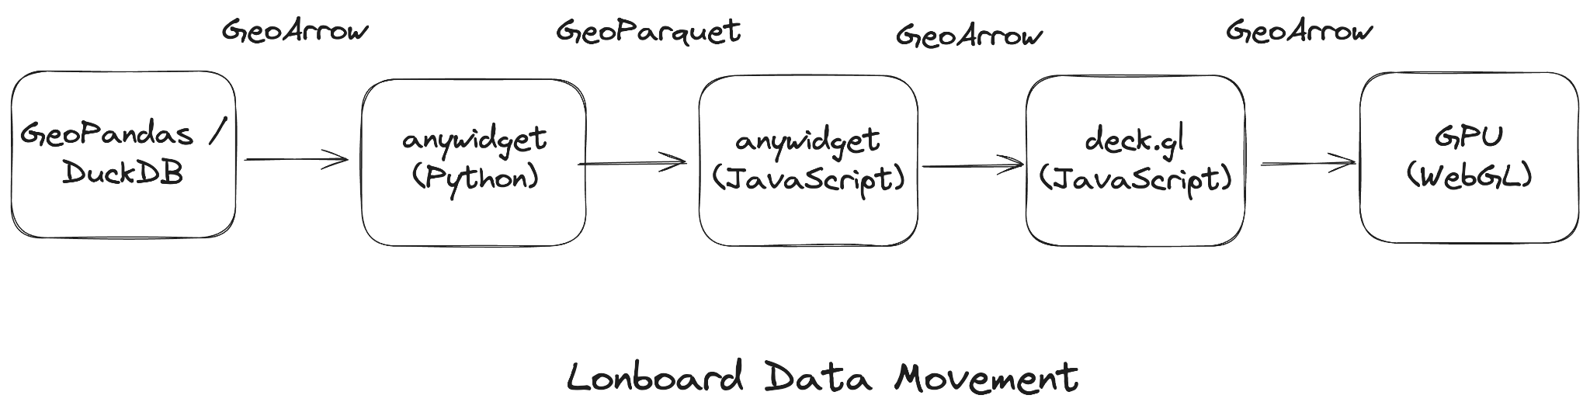
End-to-end binary data pipeline
Notes:
GPU doesn’t matter if you’re CPU-limited; need to get data to the GPU fast enough
Enabled by WebAssembly: parse Parquet in the browser
GeoArrow & GeoParquet throughout the data pipeline.
Python: GeoPandas to GeoArrow to Parquet.
Transfer compressed binary buffers to the Browser.
JavaScript: Decode Parquet to GeoArrow.
deck.gl: Pass GeoArrow buffers to the GPU.

Slide 12
moar webassembly?
[demo]
jupyterlite.ds.io

Slide 13
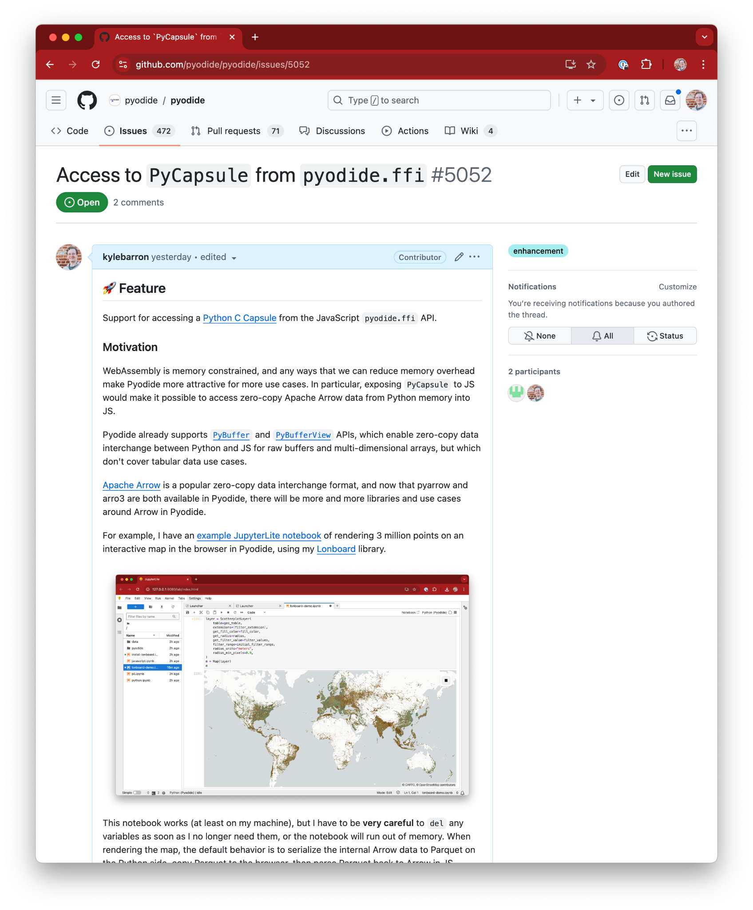
Future work
Zero-copy data serialization from Python to JS
Instantly render a map from Python data
Reduce memory overhead
Notes:
Needed to find meaningful project
Been working with Parquet files
Possible to write this all in JS, but would be a massive time/engineering investment

